Slide 2
Cleveland Intellectual Property Law Association Patent Trial and Appeal Board Update
Kalyan Deshpande, Lead Administrative Patent Judge
February 10, 2020

Slide 3
PTAB organizational structure
Scott R. Boalick, Chief Judge
Jacqueline W. Bonilla, Deputy Chief Judge
Michael W.
Kim
Vice Chief Judge for Operations
Janet A.
Gongola
Vice Chief Judge
for Strategy
Michael P. Tierney
Vice Chief Judge
for Operations
Scott C. Weidenfeller
Vice Chief Judge
for Operations
Troy Tyler
Board Operations Division
Board Executive
William M.
Fink
Vice Chief Judge for Operations

Slide 4
Board size over time
(Calendar year)
Notes:
Description: This chart shows the growth in the APJ ranks through 2018.
Talking Points:
- Since the enactment of the AIA, PTAB has grown quickly to approximately 272 judges. The incoming AIA workload has leveled off and we plan to hold the judge ranks stable at current levels.

Slide 5
Ex parte appeal statistics
September 2020

Slide 6
Pending appeals FY10 to FY20 (Sept. 30, 2010 – Sept. 30, 2020)

Slide 7
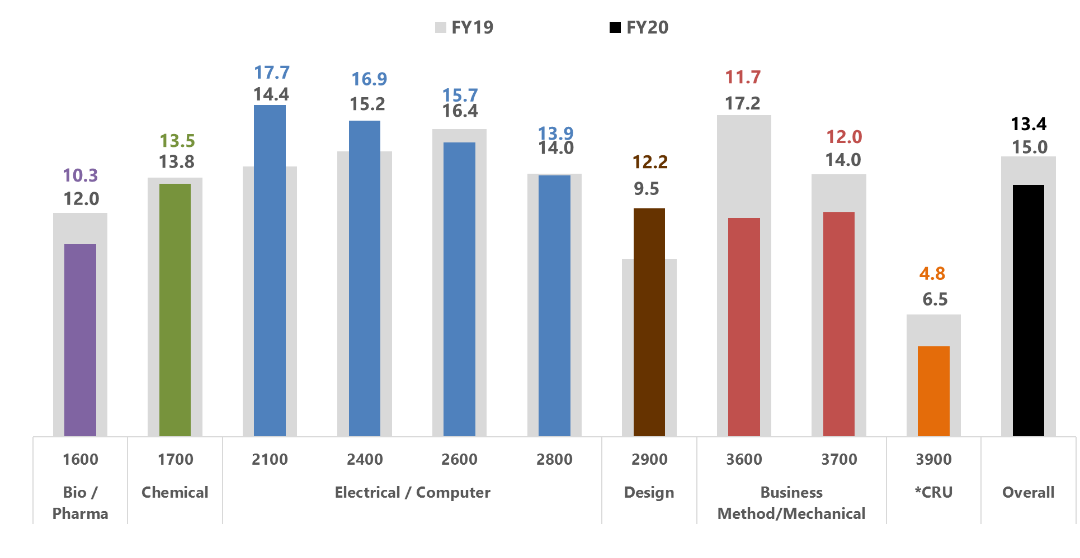
Pendency of decided appeals (Jul. 2019 – Sept. 2019 compared to Jul. 2020 – Sept. 2020)
Pendency is calculated as average months from Board receipt date to final decision.
Pendency is calculated for a three month period compared to the same period the previous year.
*CRU (Central Reexamination Unit) decisions include 10 ex parte reexams, 0 inter partes reexam, 4 supplemental examination reviews, and 9 reissues from all technologies for Jul. – Sept. FY20.

Slide 8
Appeal intake in FY20 (Oct. 1, 2019 – Sept. 30, 2020)
*The Central Reexamination Unit includes ex parte reexams, inter partes reexams, supplemental examination reviews and reissues from all technologies.

Slide 9
Appeal outcomes in FY20 (Oct. 1, 2019 - Sept. 30, 2020)

Slide 10
AIA statistics (IPR, PGR, CBM)
September 2020

Slide 11
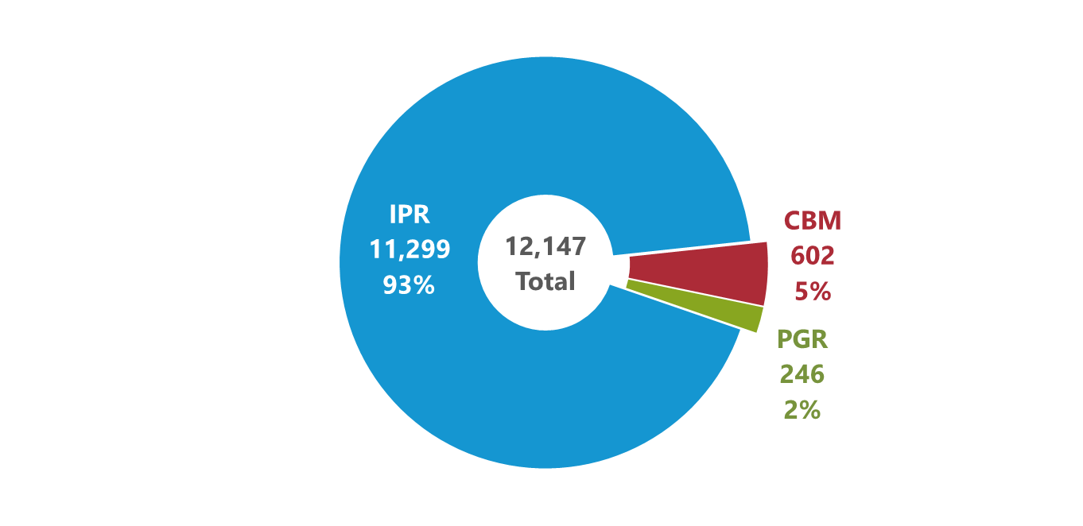
Petitions by trial type (All time: Sept. 16, 2012 to Sept. 30, 2020)
Trial types include Inter Partes Review (IPR), Post Grant Review (PGR), and Covered Business Method (CBM).

Slide 12
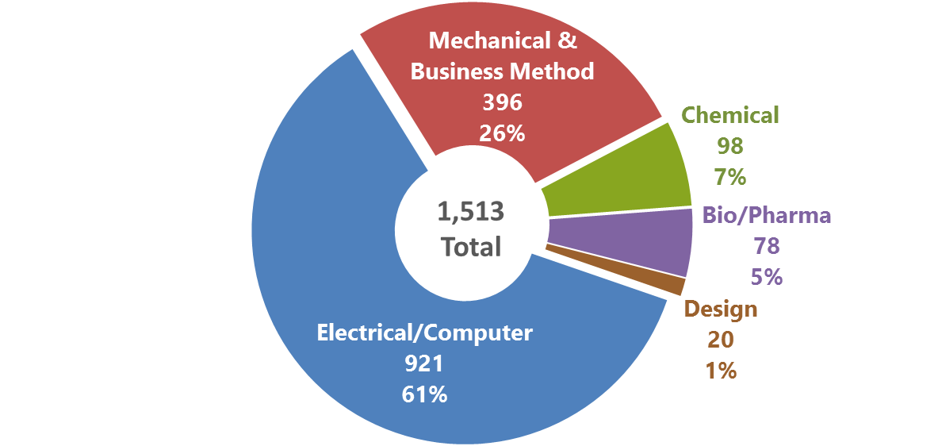
Petitions filed by technology in FY20 (FY20: Oct. 1, 2019 to Sept. 30, 2020)

Slide 13
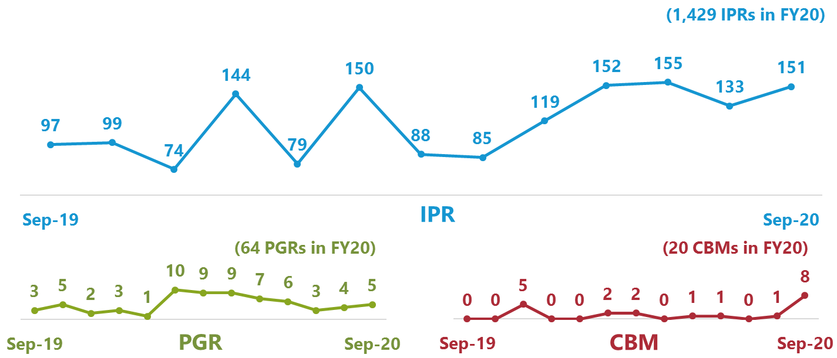
Petitions filed by month (Sept. 2020 and previous 12 months: Sept. 1, 2019 to Sept. 30, 2020)

Slide 14
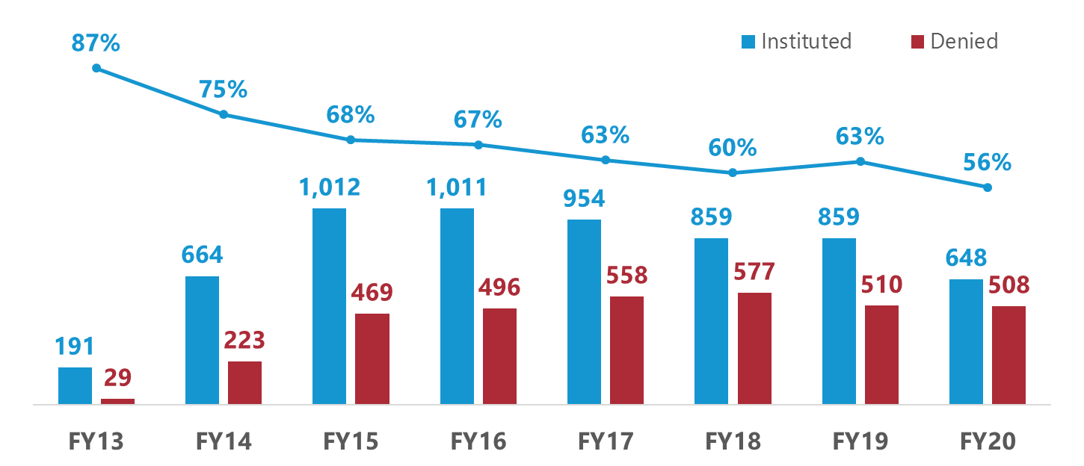
Institution rates (FY13 to FY20: Oct. 1, 2012 to Sept. 30, 2020)
Institution rate for each fiscal year is calculated by dividing petitions instituted by decisions on institution (i.e., petitions instituted plus petitions denied). The outcomes of decisions on institution responsive to requests for rehearing are excluded.

Slide 15
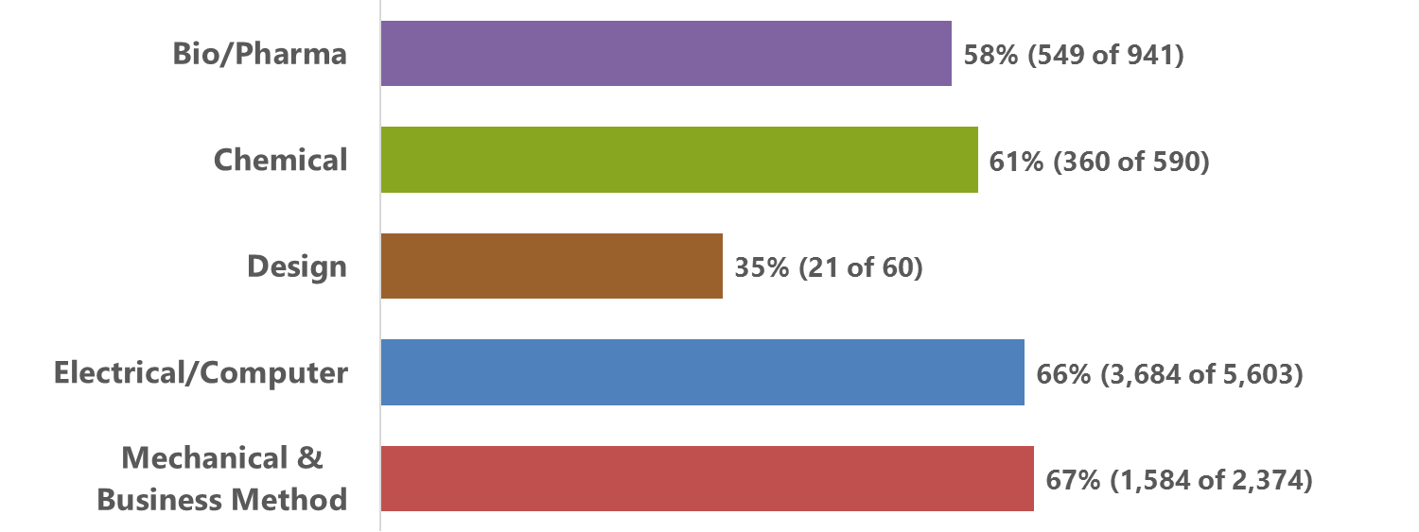
Institution rates by technology (All time: Sept. 16, 2012 to Sept. 30, 2020)
Institution rate for each technology is calculated by dividing petitions instituted by decisions on institution (i.e., petitions instituted plus petitions denied). The outcomes of decisions on institution responsive to requests for rehearing are excluded.

Slide 16
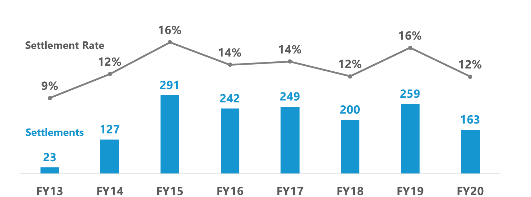
Pre-institution settlements (FY13 to FY20: Oct. 1, 2012 to Sept. 30, 2020)
Settlement rate for each year is calculated by dividing pre-institution settlements by the sum of proceedings instituted, denied institution, dismissed, terminated with a request for adverse judgment, and settled before decision on institution.

Slide 17
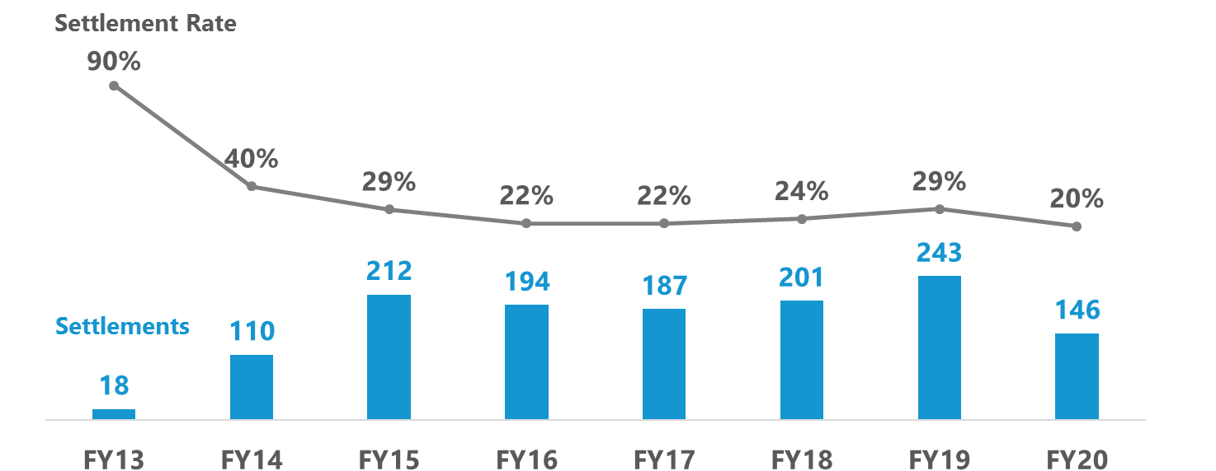
Post-institution settlements (FY13 to FY20: Oct. 1, 2012 to Sept. 30, 2020)
Settlement rate for each year is calculated by dividing post-institution settlements by proceedings terminated post-institution (i.e., settled, dismissed, terminated with a request for adverse judgment, and final written decision), excluding joined cases.

Slide 18
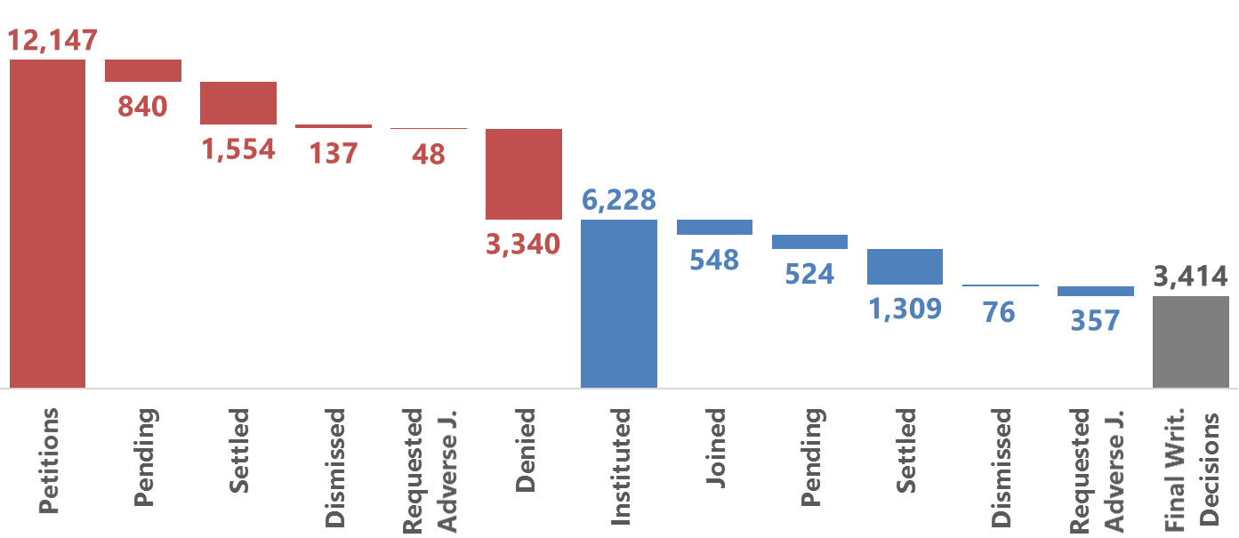
Status of petitions (All time: Sept. 16, 2012 to Sept. 30, 2020)
These figures reflect the latest status of each petition. The outcomes of decisions on institution responsive to requests for rehearing are incorporated. Once joined to a base case, a petition remains in the Joined category regardless of subsequent outcomes.

Slide 19
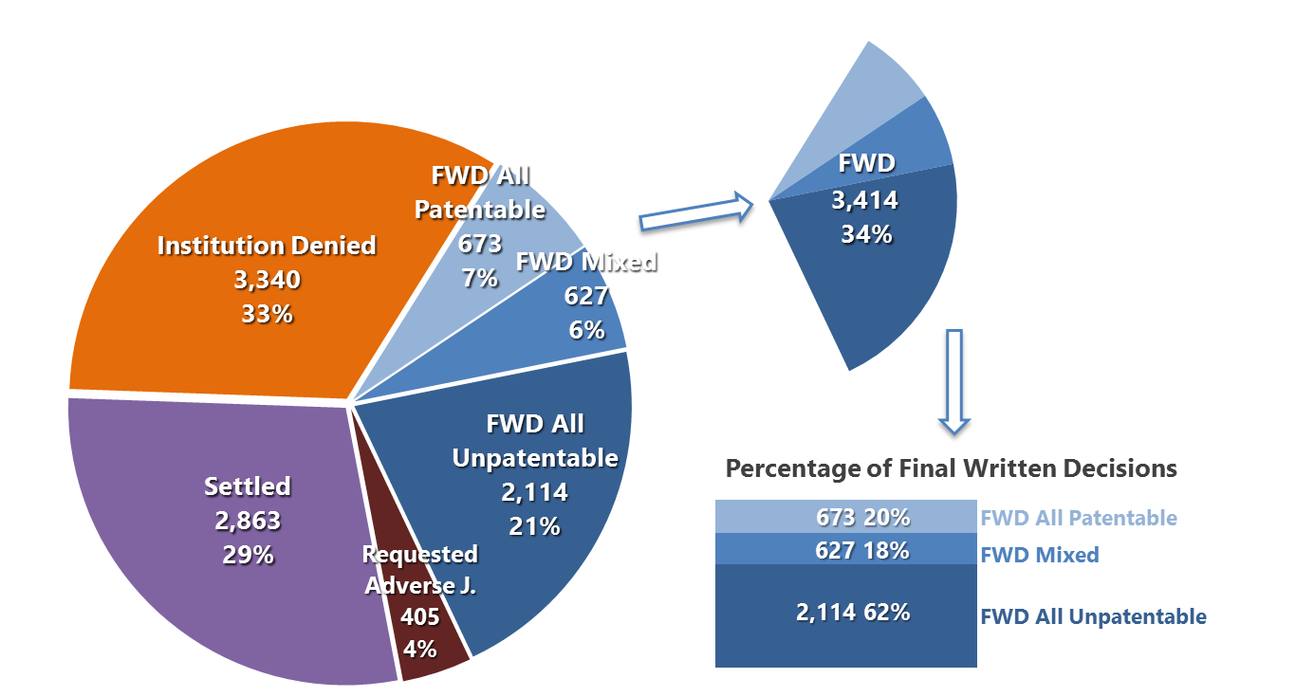
Outcome of concluded proceedings (All time: Sept. 16, 2012 to Sept. 30, 2020)
Joined and dismissed cases are excluded.

Slide 20
New AIA trial statistics

Slide 21
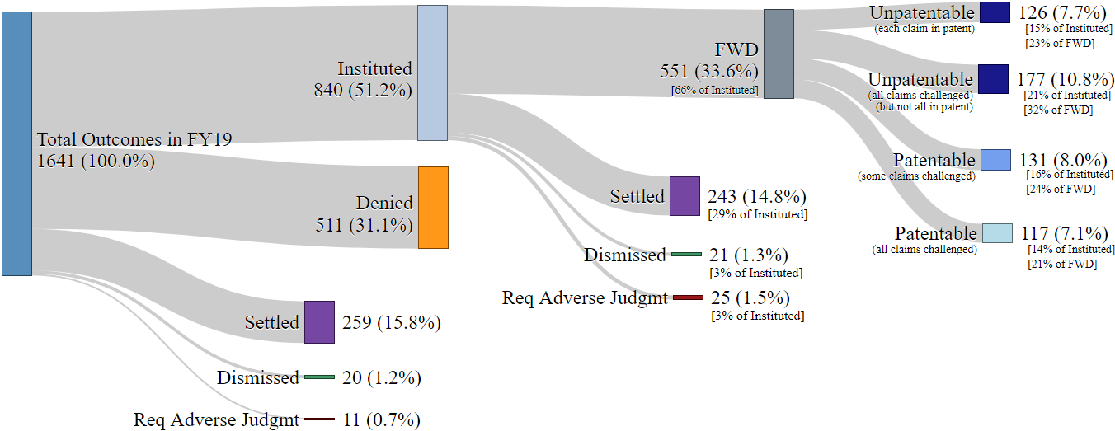
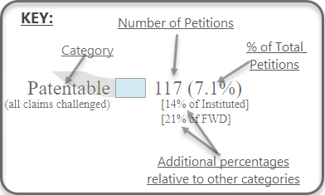
Outcomes in FY19, by petition
Graphic presents status of each proceeding concluding in FY19; pending and joined cases are excluded.

Slide 22
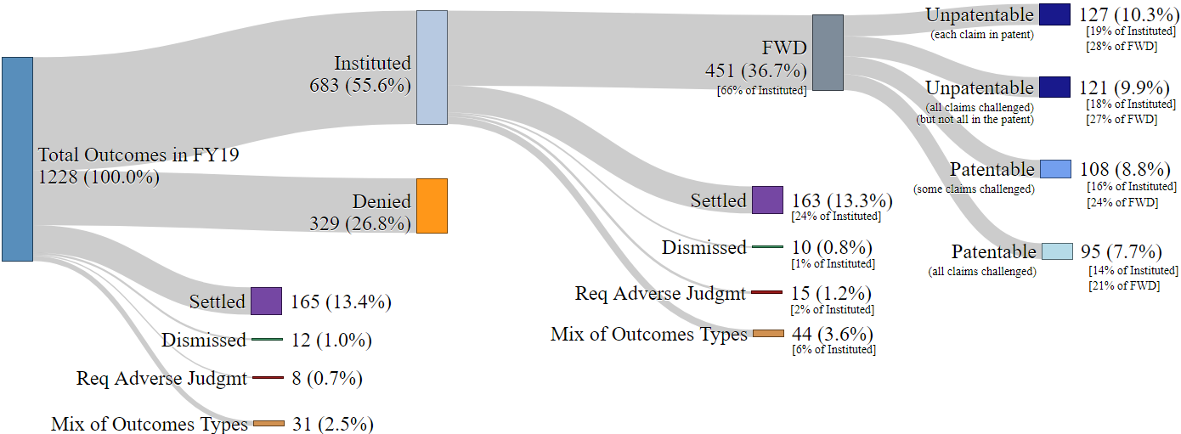
Outcomes in FY19, by patent
If the petitions challenging the patent had a mix of:
Settled,
Req. Adv. Judgmt,
Dismissed, and/or
Denied
Graphic presents status of each patent after last proceeding on patent concluded in FY19; pending and joined cases are excluded.

Slide 23
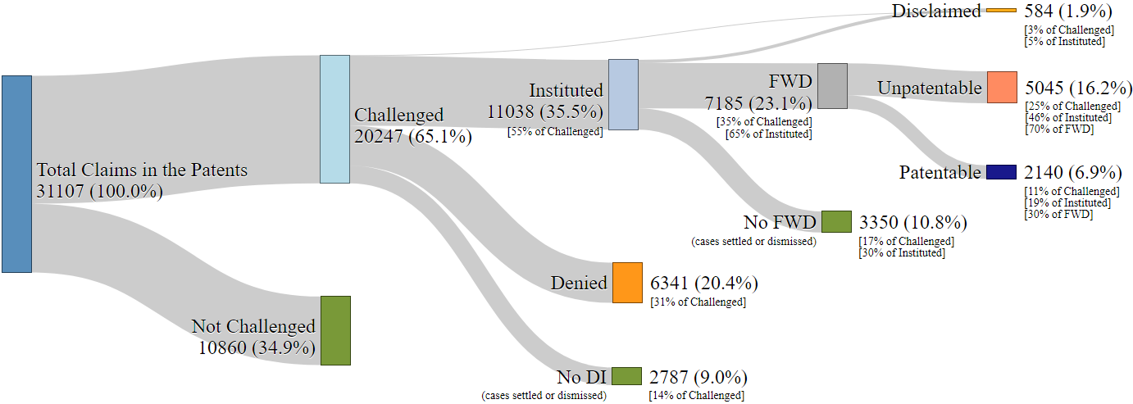
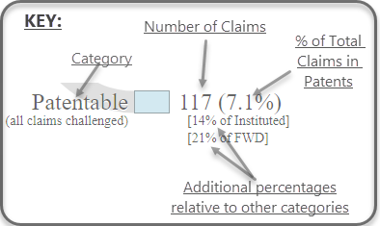
Outcomes in FY19, by claim
Graphic presents status of each claim after last proceeding on claim concluded in FY19; pending and joined cases are excluded.

Slide 24
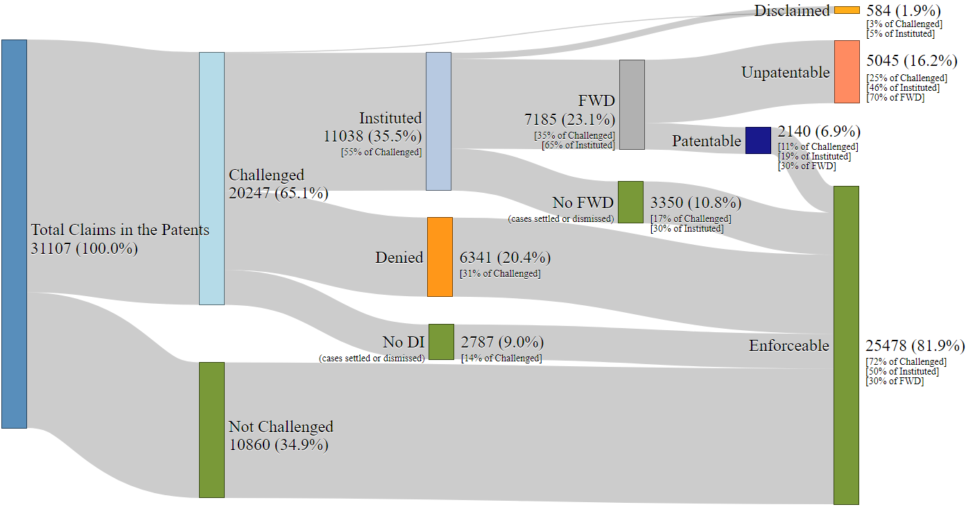
Outcomes in FY19, by claim
*
Graphic presents status of each claim after last proceeding on claim concluded in FY19; pending and joined cases are excluded.

Slide 25
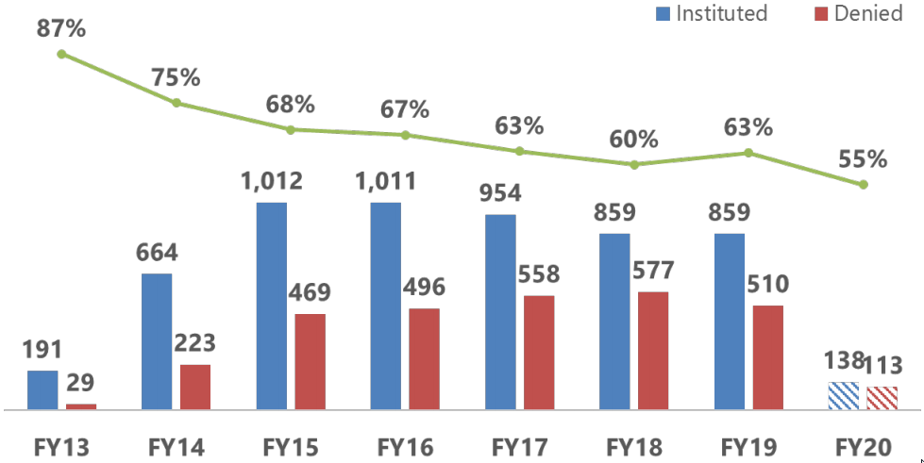
Institution rates by petition (FY13 to FY20: Oct. 1, 2012 to Dec. 31, 2019)
Institution rate
Decisions
Institution rate for each fiscal year is calculated by dividing petitions instituted by decisions on institution (i.e., petitions instituted plus petitions denied). The outcomes of decisions on institution responsive to requests for rehearing are excluded.

Slide 26
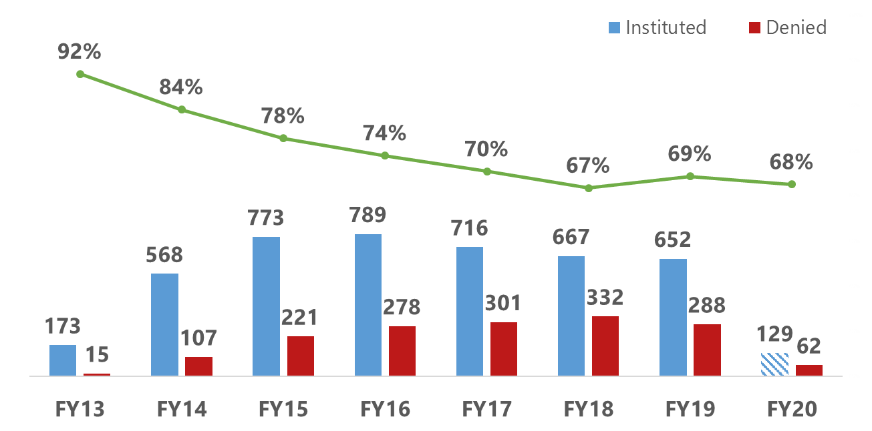
Institution rates by patent (FY13 to FY20: Oct. 1, 2012 to Dec. 31, 2019)
Institution rate
Decisions
A patent is “instituted” if any petition challenging that patent is instituted. A patent is “denied” if no petitions challenging that patent are instituted. Patents that have not received a Decision on Institution are not included in this data set.

Slide 27
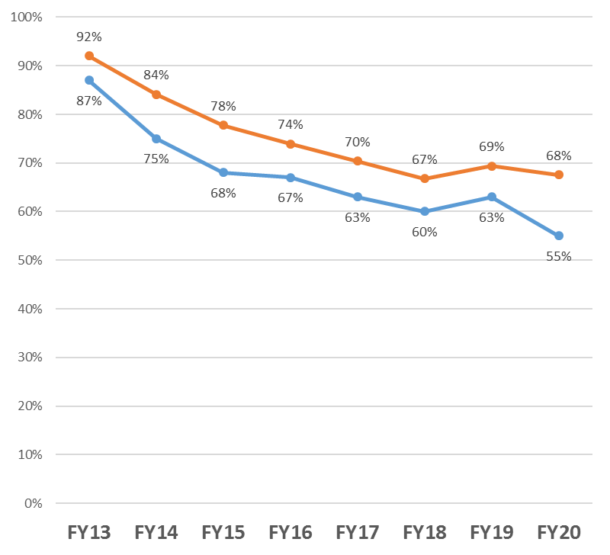
Institution rates by petition vs by patent
By patent
By petition

Slide 28
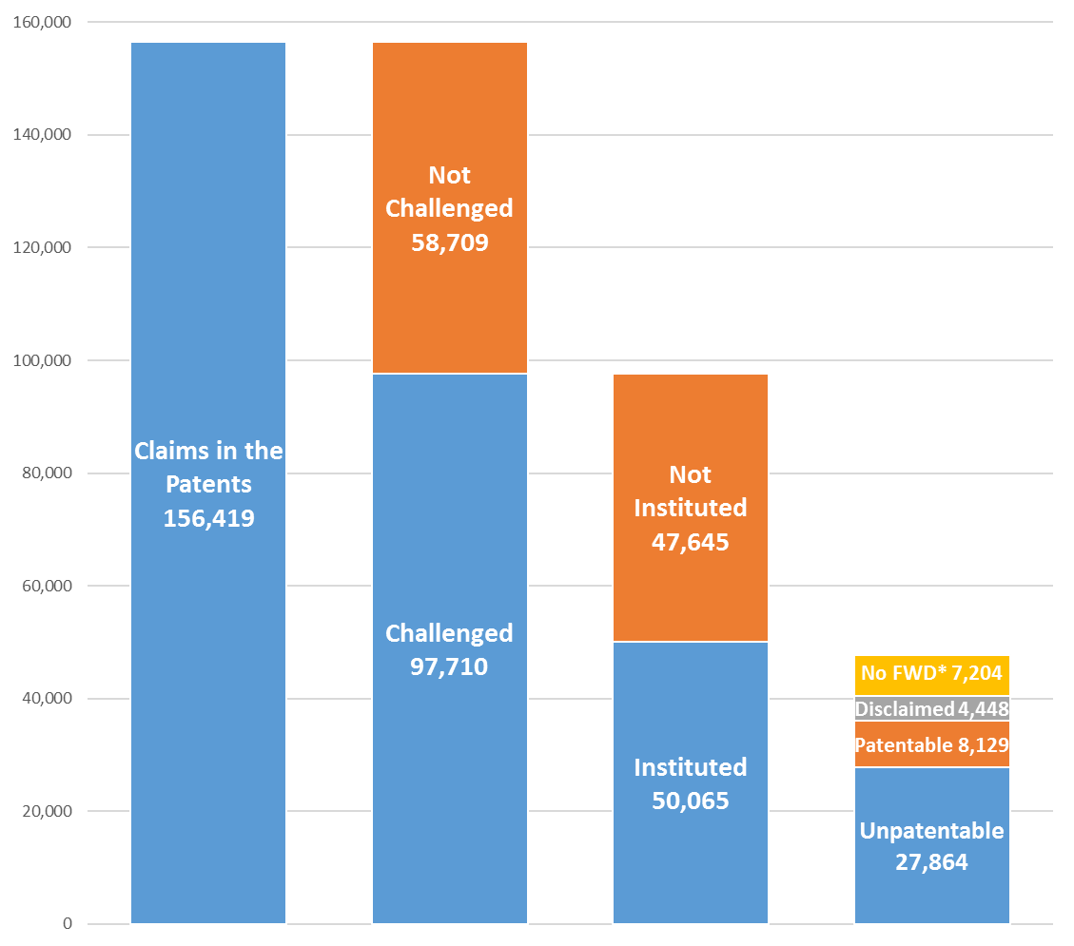
Claim outcomes of patents
(All time: FY11 through FY19)
Pending cases are excluded.
Claims Found Unpatentable in Final Written Decisions =
18% of Claims in Challenged Patents
29% of Claims Challenged
56% of Claims Instituted
*No FWD means the claim was instituted but never received a FWD (e.g., the underlying cases were settled or dismissed).

Slide 29
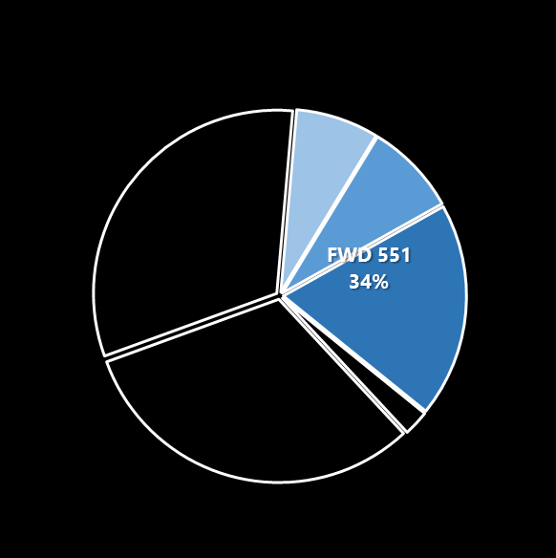
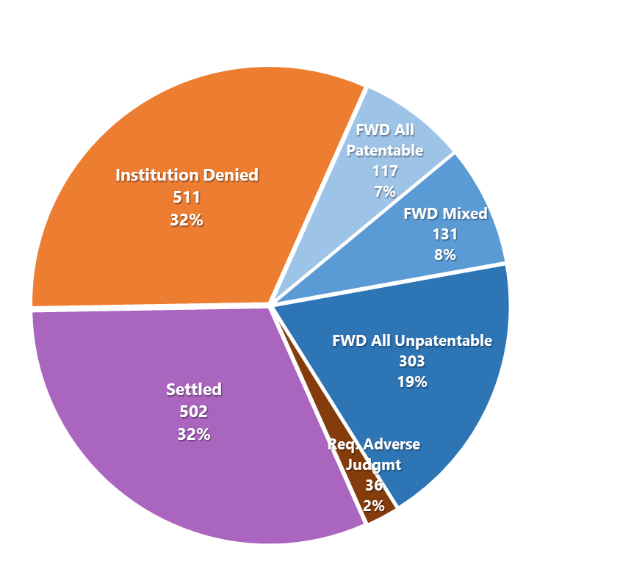
Outcomes in FY19, by petition
Percentage of the final written decisions
Joined and dismissed cases excluded.

Slide 30
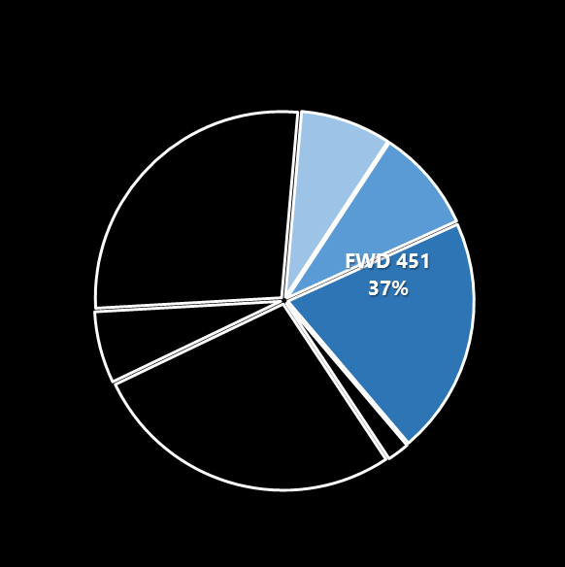
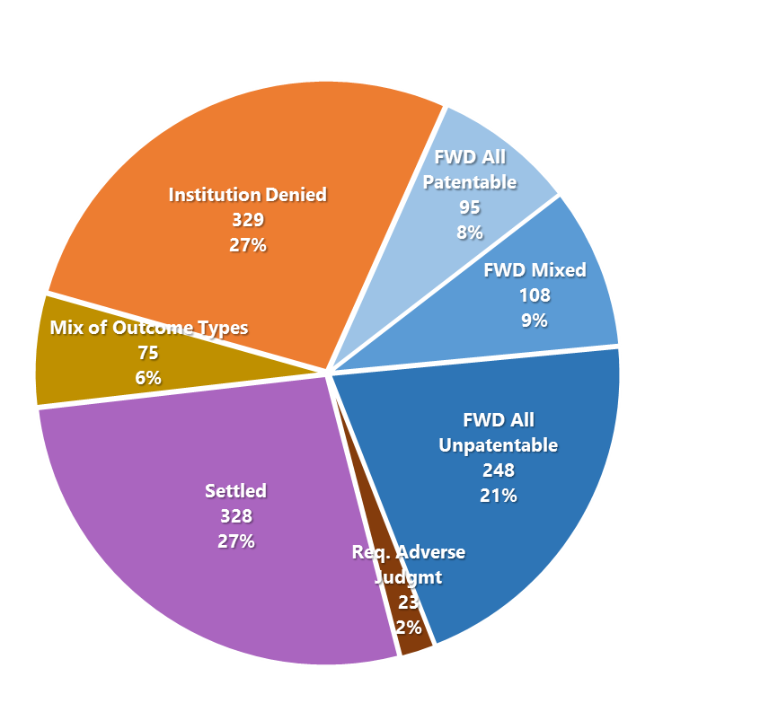
Outcomes in FY19, by patent
Percentage of the final written decisions
Joined and dismissed cases excluded. FWD patentability or unpatentability reported with respect to the claims challenged. “Mix of Outcome Types” means patent saw a mix of denied, settled, and req. adverse judgment.

Slide 31
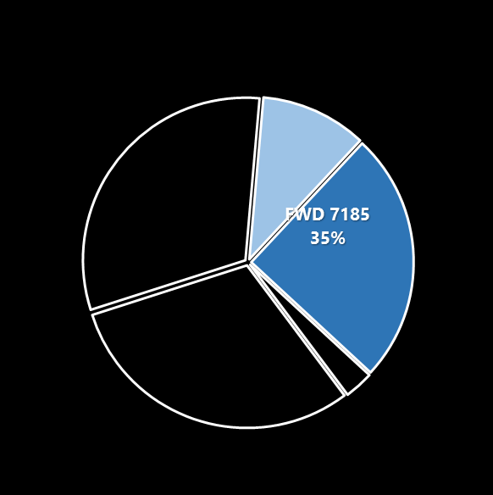
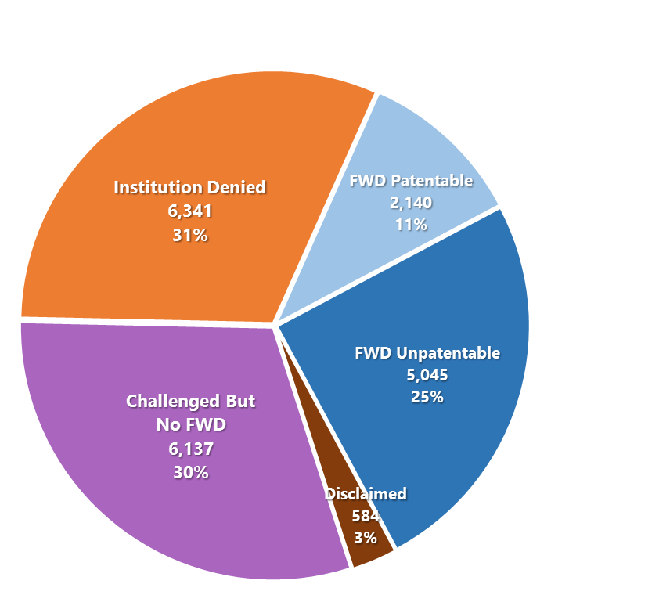
Outcomes in FY19, by claim challenged
Percentage of the final written decisions
FWD patentability or unpatentability reported with respect to the claims challenged.

Slide 32
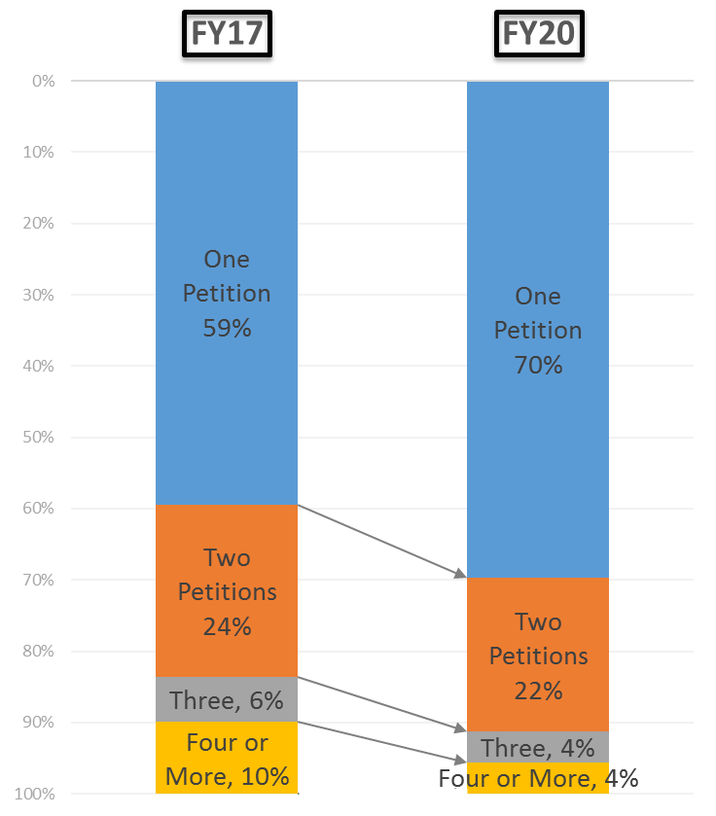
Multiple petitions: pre-General Plastic vs. today
Patent Challenged by: | FY17 (%) | FY20 (%) | % Change
One Petition | 59 | 70 | 19%
Two Petitions | 24 | 22 | -8%
Three | 6 | 4 | -33%
Four or More | 10 | 4 | -60%
Each bar accounts for all patents challenged during the indicated FY timeframe, and counts the total number of petitions ever filed with respect to those patents from September 16, 2012, up to the end of that FY timeframe. The timeframe for FY17 is the entire year, and the timeframe for FY20 is through the end of Q1.

Slide 33
Recent changes to PTAB practice

Slide 34
Recent changes to PTAB practice
Revised claim construction standard used in AIA proceedings (Nov. 2018)
Motion to amend practice pilot program (March 2019)
Notice explaining reissue and reexamination options (April 2019)
Standard Operating Procedures
SOP 1 (paneling)
SOP 2 (two new processes to designate decisions precedential or informative, including POP review on rehearing)
2019 revised patent subject matter eligibility guidance
Impacting ex parte appeals and AIA cases
Updates to Trial Practice Guide (consolidated in Nov. 2019)
E.g., factors considered at institution in AIA proceedings

Slide 35
Recent changes to PTAB practice
Director issued memorandum clarifying interpretation of § 311(b) in relation to applicant admitted prior art
Director issued memorandum clarifying the approach to indefiniteness in AIA trial proceedings.
Fast-Track Appeals Pilot Program
Legal Experience and Advancement Program (LEAP)
Rulemaking to allocate burdens of persuasion on motions to amend in AIA trial proceedings
Rulemaking on AIA trial institution and responsive briefing
Extended deadlines under the CARES Act
Precedential Opinion Panel (POP) issued four notable precedential decisions

Slide 36
Recently designated decisions

Slide 37
Recently designated decisions
Real Party-in-Interest (designated Dec. 4, 2020)
RPX Corp. v. Applications in Internet Time, LLC, IPR2015-01750, Paper 128 (Oct. 2, 2020) (precedential)
SharkNinja Operating LLC v. iRobot Corp., IPR2020-00734, Paper 11 (Oct. 6, 2020) (precedential)
Joinder (designated Dec. 4, 2020)
Apple Inc. v. Uniloc 2017 LLC, IPR2020-00854, Paper 9 (Oct. 28, 2020) (precedential)
Exercising Discretion under 314 (Fintiv) (designated Dec. 17, 2020)
Sotera Wireless, Inc. v. Masimo Corp., IPR2020-01019, Paper 12 (Dec. 1, 2020) (precedential as to § II.A)
Snap, Inc. v. SRK Tech. LLC, IPR2020-00820, Paper 15 (Oct. 21, 2020) (precedential as to § II.A)

Slide 38
RPX Corp. v. Applications in Internet Time, LLC IPR2015-01750
Determined petitioner bears the burden to establish no RPI or privy was served with a complaint alleging infringement more than one year prior to the filing of the petition.
Whether a non-party is a RPI or privy is a fact-dependent question demanding a flexible approach to determine who, from a practical and equitable standpoint, will benefit from the redress that the inter partes review might provide.

Slide 39
SharkNinja Operating LLC v. iRobot Corp. IPR2020-00734
Determined to not address whether a party is an unnamed RPI when it would not create a time bar or estoppel under 35 U.S.C. § 315.
Such a lengthy exercise is unnecessary for the purposes of rendering a decision on institution of trial when there is no time bar implication.
Identification of all “correct” RPIs under 35 U.S.C. 312(a)(2) is not jurisdictional.
See Lumentum Holdings, Inc. v. Capella Photonics, Inc., PR2015-00739, Paper 38 at 6 (PTAB Mar. 4, 2016) (precedential).

Slide 40
Apple Inc. v. Uniloc 2017 LLC IPR2020-00854
The Petition in IPR2020-00854 is undeniably the second petition Apple has filed challenging the ’088 patent.
Applied the General Plastic factors to a follow-on petition that is accompanied with a motion for joinder.
Determined, after a holistic review of the General Plastic factors that the facts weigh in favor of exercising discretion to deny institution.
See General Plastic Industrial Co., Ltd. v. Canon Kabushiki Kaisha, IPR2016- 01357, Paper 19 (PTAB Sept. 6, 2017) (precedential as to § II.B.4.i)).

Slide 41
Sotera Wireless, Inc. v. Masimo Corp. IPR2020-01019
Petitioner broadly stipulates to not pursue “any ground raised or that could have been reasonably raised.”
Petitioner’s broad stipulation addresses concerns of duplicative efforts and potentially conflicting decisions, ensuring that an inter partes review is a “true alternative” to the district court proceeding.
Determined that Petitioner’s broad stipulation weighed strongly against the exercise of discretion to deny institution of inter partes review.

Slide 42
Snap, Inc. v. SRK Tech. LLC IPR2020-00820
The district court’s stay of the litigation pending denial of institution or a final written decision allays concerns about inefficiency and duplication of efforts.
Determined that the granting of a stay pending inter partes review weighs strongly against exercising discretion to deny inter partes review.

Slide 43
Final rules related to institution of trials

Slide 44
Final rule on AIA trial institution and responsive briefing
On December 9, 2020, the USPTO published a final rule revising rules on institution and sur-replies.
The new rule is effective on January 8, 2021, and applies to all IPR and PGR petitions filed on or after January 8, 2021.
The following slides highlight the three primary changes to AIA trial practice.

Slide 45
Final rule on AIA trial institution and responsive briefing
First, the final rule implements the U.S. Supreme Court’s decision in SAS Institute Inc. v. Iancu, 138 S. Ct. 1348 (2018) that a decision to institute an IPR under 35 U.S.C. § 314 may not institute on fewer than all claims challenged in a petition.
In all pending IPR, PGR, and CBM proceedings before the Office, the Board will either institute review on all of the challenged claims and grounds of unpatentability presented in the petition or deny the petition.

Slide 46
Final rule on AIA trial institution and responsive briefing
Second, the final rule revises the rules to conform to the current standard practice of providing for automatic sur-replies.
Amends the rules to set forth the briefing requirements of sur-replies to principal briefs and to provide that a reply and a patent owner response may respond to a decision on institution.

Slide 47
Final rule on AIA trial institution and responsive briefing
Third, the final rule eliminates the presumption that a genuine issue of material fact is viewed in the light most favorable to the petitioner for purposes of deciding whether to institute a review.
As with all other evidentiary questions at the institution phase, the Board will consider all evidence to determine whether the petitioner has met the applicable standard for institution of the proceeding.

Slide 48
Final rules concerning the burdens of persuasion in motions to amend

Slide 49
Background
On October 4, 2017, Aqua Prods., Inc. v. Matal, 872 F.3d 1290 (Fed. Cir. 2017), concluded that, in the absence of rulemaking, the burden of proving the unpatentability of substitute claims proposed in a motion to amend could not be placed on patent owner.
On June 1, 2018, Western Digital Corp. v. SPEX Techs., Inc., IPR2018-00082, -00084 (PTAB Apr. 25, 2018) (Paper 13) was designated as informative.
Provided information and guidance about motions to amend, including on burdens of persuasion
On October 29, 2018, the Office published a “Request for Comments” on motion to amend practice and procedures in AIA trials (83 FR 54319), seeking public comment on various aspects of Board’s amendment practice, including the allocation of burdens of persuasion.

Slide 50
Background
25 commenters to Request for Comments provided specific responses to questions 15 and 16 relating to allocation of burdens:
Majority was in favor of the Office engaging in rulemaking to allocate the burdens of persuasion as set forth in Western Digital.
On March 7, 2019, Western Digital (informative) was replaced by Lectrosonics Inc. v. Zaxcom Inc., IPR2018-01129, -1130, (PTAB Feb. 25, 2019) (Paper 15) (precedential) (presenting same allocation of burdens)
Majority stated that the Board should be able to justify findings of unpatentability, even when the petitioner remains in the proceeding.

Slide 51
Background
On March 15, 2019, the Office published a Notice regarding a new pilot program concerning motions to amend.
On October 22, 2019, the Office published a Notice of Proposed Rulemaking (NPRM) regarding the burdens of persuasion in relation to motions to amend.
Received 18 comments from intellectual property organizations, trade organizations, companies, and individuals.
On July 6, 2020, the Precedential Opinion Panel (POP) issued Hunting Titan, Inc. v. DynaEnergetics Europe GmbH, IPR2018-00600 (Paper 67).

Slide 52
Final rule
On December 21, 2020, the Office issued a final rule amending 37 C.F.R. § 42.121 and § 42.221 to add new subsection (d), allocating burdens of persuasion in relation to a motion to amend (MTA).
Assigns to patent owner the burden of showing that a MTA complies with certain statutory and regulatory requirements for such a motion.
Assigns to petitioner the burden of showing the unpatentability of substitute claims.
Irrespective of burdens, provides that the Board itself may, in the interests of justice, exercise its discretion to grant or deny a MTA only for reasons supported by readily identifiable and persuasive evidence of record in the proceeding.

Slide 53
Final rule – allocation of burden
A patent owner bears the burden to show, by a preponderance of the evidence, that a MTA complies with statutory (35 U.S.C. 316(d), 326(d)) and regulatory (37 CFR 42.121, 42.221) requirements:
proposes reasonable number of substitute claims,
responds to a ground of unpatentability involved in the trial,
does not enlarge the scope of the claims,
does not introduce new matter, and
sets forth written description support in the originally filed disclosure (or earlier-filed disclosure) for each claim added or amended.

Slide 54
Final rule – allocation of burden
When opposing a motion to amend, a petitioner bears the burden to show, by a preponderance of the evidence, that proposed substitute claims are unpatentable.

Slide 55
Final rule – Board discretion
Irrespective of the burdens and the adversarial nature of the proceeding, the Board may, in the interests of justice, exercise its discretion to grant or deny a MTA, but only for reasons supported by readily identifiable and persuasive evidence of record in the proceeding.
In doing so, the Board may make of record only readily identifiable and persuasive evidence in a related proceeding before the Office or evidence that a district court can judicially notice.
Where the Board exercises its discretion, the parties will have an opportunity to respond.

Slide 56
Final rule – Board discretion
The Office anticipates that the Board will exercise its discretion in the context of MTAs only in rare circumstances.
Specifically, the “interests of justice”
means that the Board will apply the same standards articulated in Hunting Titan, and
refers to situations in which the adversarial process fails to provide the Board with potential arguments relevant to granting or denying a MTA.

Slide 57
Final rule – Board discretion
The Board may determine that a MTA complies with statutory and regulatory requirements, even if a patent owner does not expressly address or establish every requirement in its motion.
The Office expects that the Board will do so only in circumstances where:
evidence of compliance with those requirements is so readily identifiable and persuasive that the Board should take it up in the interest of supporting the integrity of the patent system, notwithstanding the adversarial nature of the proceedings, and
only where the petitioner has been afforded the opportunity to respond to that evidence.

Slide 58
Final rule – Board discretion
Similarly, when in the interests of justice, the Board may deny a MTA, even in instances where the petitioner does not oppose the motion or does not meet its burden of showing unpatentability.
Such instances include, for example:
petitioner has ceased to participate in the proceeding altogether (for example, as a result of settlement),
petitioner remains in the proceeding but choses not oppose the MTA, and
certain evidence regarding unpatentability has not been raised by either party but is so readily identifiable and persuasive that the Board should take it up in the interest of supporting the integrity of the patent system, notwithstanding the adversarial nature of the proceedings.

Slide 59
Final rule – Board discretion
Ordinarily, in cases where the petitioner has participated fully and opposed the motion to amend, the Office expects that:
petitioner will bear the burden of persuasion and there will be no need for the Board to independently justify a determination of unpatentability, and
the Board will do so only in the interests of justice and in rare circumstances, and only where the patent owner has been afforded the opportunity to respond to the evidence and related grounds of unpatentability.

Slide 60
Indefiniteness standard to be applied by the Board in AIA trials

Slide 61
Approach to indefiniteness in AIA trial proceedings
On January 6, 2021, the USPTO issued a memorandum clarifying the approach to indefiniteness in AIA trial proceedings.
In AIA trial proceedings, the Board will now adhere to the approach used by the district courts, as set forth in Nautilus.
The memorandum applies only to AIA trial proceedings. The USPTO will continue to follow Packard in the examination context, which includes appeals from original examination, reexamination, and reissue applications.
Eliminating the differences between indefiniteness approaches used in the district courts and before the Board in AIA trial proceedings will lead to greater uniformity and predictability, improve the integrity of the patent system, and help increase judicial efficiency.

Slide 62
PTAB anonymous decision nomination form

Slide 63
PTAB anonymous decision nomination form
Published September 24, 2020.
Accessible on the PTAB’s Precedential and informative decisions page of the USPTO website.
Allows any member of the public to nominate any PTAB decision for precedential or informative designation.

Slide 64
PTAB anonymous decision nomination form
Provide as much identifying information as possible.
Set forth a brief description of the reasons for the requested designation.
May also enter name and email address.

Slide 65
PTAB anonymous decision nomination form

Slide 66
Precedential Opinion Panel (POP) request amicus form

Slide 67
POP request amicus form
Published November 19, 2020.
Accessible the PTAB’s Precedential Opinion Panel page of the USPTO website.
Allows the submission of an amicus request addressing a pending request for POP review.

Slide 68
POP request amicus form
Must be made within seven business days of entry of the Notification of Receipt of POP Request into the case docket or patent application file.
Must include case identifying information:
name of the submitter,
any affiliation, and
any client represented.
Option to explain why the POP request should or should not be granted.

Slide 69
POP request amicus form

Slide 70
Kalyan Deshpande
Lead Administrative Patent Judge
Kalyan.Deshpande@uspto.gov
571-272-9797

